Slide 1
GAS (Gait Analysis System)
Making physical therapy easier for everyone
TEAM MEMBERS:
ZOE FOWLER, HOLIDAY GARRISON, RYAN HOPSON, MUAMMAR SAEED, CHRIS SLAGELL

Slide 2


Team Members
Zoe Fowler (Team Lead & Hardware Design – Ankle Bracelet Subsystem)
Chris Slagell (Hardware Design – Belt Subsystem and Subsystem Connection)

Slide 3



Team Members
Muammar Saeed (Software Design – Smartphone Application)
Holiday Garrison
(Software Design – Sensor Detection)
Ryan Hopson
(Software Design – Data Processing)

Slide 4

Faculty Advisor
Dr. James E. Fowler
William L. Giles Distinguished Professor
Professor, Mississippi State University
Department of Electrical and Computer Engineering
B.S., M.S., Ph.D., Ohio State University

Slide 5

External Advisor
Tracy Blackstock
Physical Therapist, Sta-Home Health & Hospice
B.S., University of Iowa
M.P.T., University of Miami
D.P.T., A. T. Still University

Slide 6

Problem and Solution

Slide 7

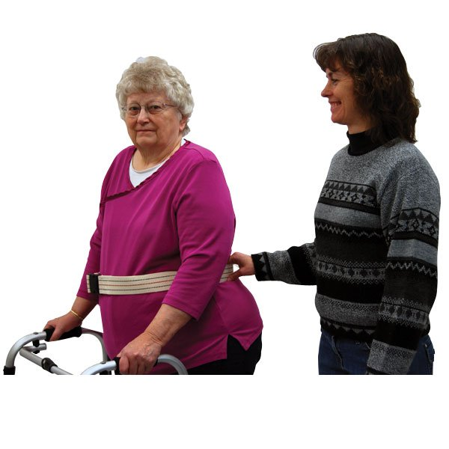
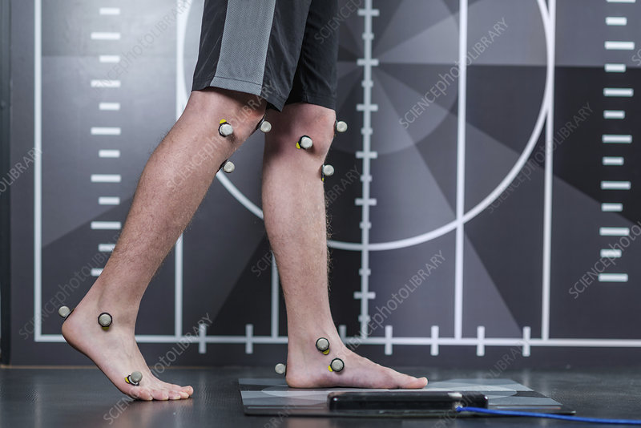
Problem
Gait analysis helps physical therapists assess ability to walk
Important for correcting injuries
Useful for determining if patient is a fall risk
No method to monitor patients between therapy sessions
[1]
[2]

Slide 8

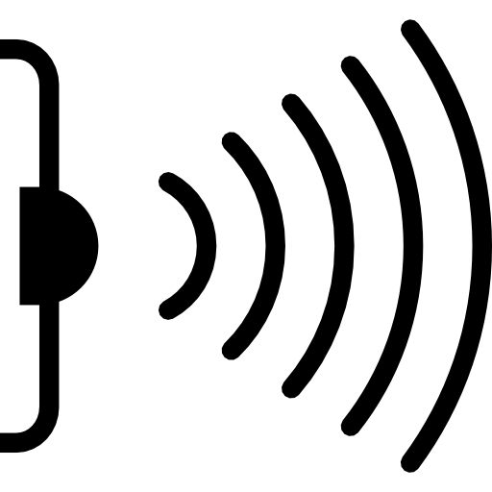
Solution
GAS is used for gait performance analysis
Comprised of a comfortable belt and two snug ankle bracelets
Uses sensors to record important walking data from the user
Physical therapists can connect to GAS via USB with no required training
[3]
[4]

Slide 9
Outline
Design & Testing
Plans & Conclusion
Constraints

Slide 10

Constraints

Slide 11
Technical Constraints
Name | Description
Battery Life | ≥ 1 hour
Waist/Ankle Size [5], [6] | Waist: 91 – 111 cm Ankle: 19.7 - 24 cm
Measurement Frequency [7] | ≤ 75 measurements per minute
Measurement Accuracy | ±5%
Memory Storage | ≥ 1 hour's worth of data

Slide 12
Practical Constraints
Type | Name | Description
Manufacturing | Weight | ≤ 2.3 kg
Economic | Price | ~$150
Cultural | Clothing | Worn over a variety of clothing
Health & Safety | Safety | Wires will not be tripped over
Cultural | Data | Multiple types of data are measured

Slide 13
Engineering Standards
Specific Standard | Standard Document | Specification / Application
USB 2.0 [8] | Universal Serial Bus Revision 2.0 Specification | USB 2.0 allows connection to the physical therapist’s app.
FDA Policy on Low-Risk General Wellness Products [9] | General Wellness: Policy for Low-Risk Devices | GAS presents a low risk to the safety of users or other persons.
HIPAA [10] | HIPAA Right of Access | GAS does not submit user information to third parties. Users can ask their physical therapists for their recorded information at any time.

Slide 14

Design and Testing

Slide 15
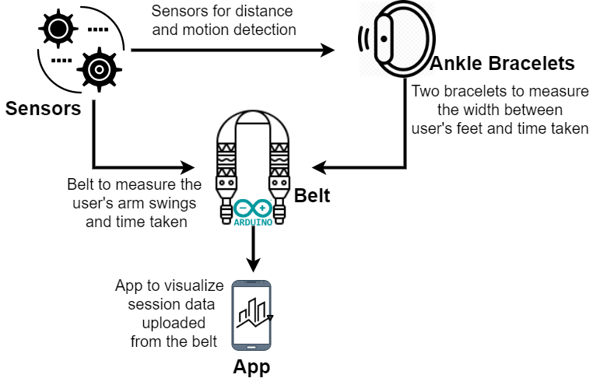
Design Overview

Slide 16
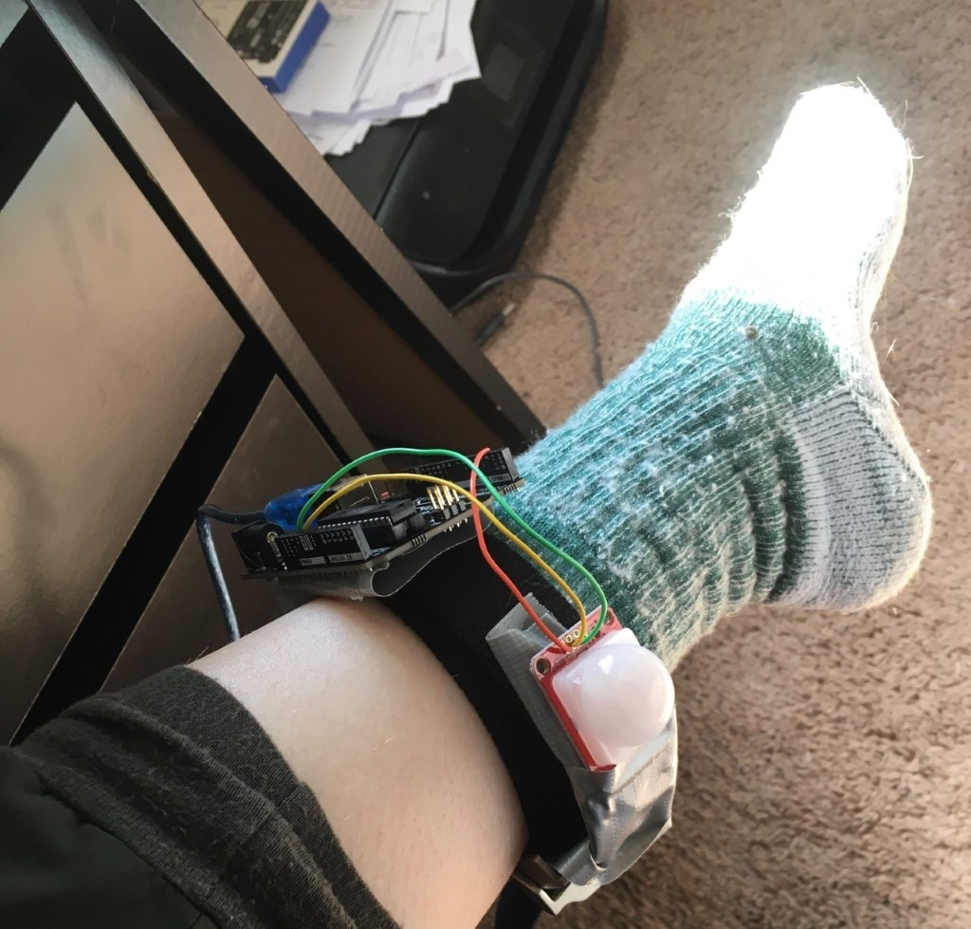
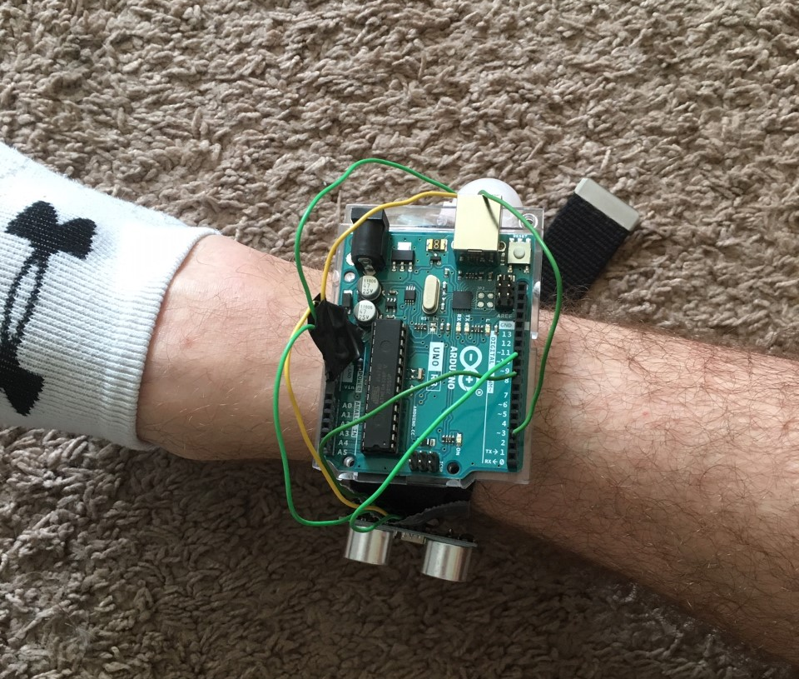
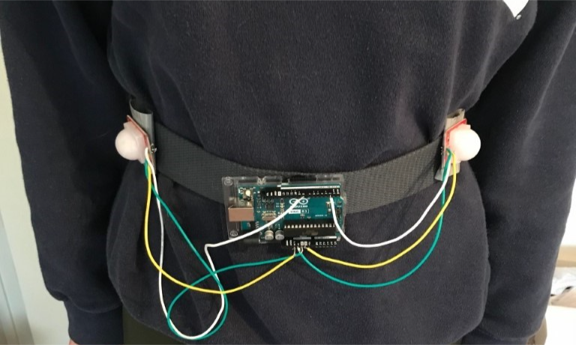
Subsystem Prototypes
Belt Subsystem
Left Ankle Bracelet Subsystem
Right Ankle Bracelet Subsystem

Slide 17
General Sensor Testing

Slide 18
PIR Sensor Testing
PIR Test Type | Angle Relative to Sensor (°) | Requirements | Distance from Sensor (cm) | Results (pirStat) | Pass/Fail
Sunlight/ Clothing | 0, 60 | pirStat == 1 | 1 | 1, 1 | Pass
 |  |  | 10 | 1, 1 | Pass
 |  |  | 50 | 1, 1 | Pass
 |  |  | 100 | 1, 1 | Pass
 |  |  | 500 | 0, 0 | Fail
Sunlight/ Bare Skin | 0, 60 | pirStat == 1 | 1 | 1, 1 | Pass
 |  |  | 10 | 1, 1 | Pass
 |  |  | 50 | 1, 1 | Pass
 |  |  | 100 | 1, 1 | Pass
 |  |  | 500 | 0, 0 | Fail

Slide 19
PIR Sensor Testing (continued)
PIR Test Type | Angle Relative to Sensor (°) | Requirements | Distance from Sensor (cm) | Results (pirStat) | Pass/Fail
Indoors/ Clothing | 0, 60 | pirStat == 1 | 1 | 1, 1 | Pass
 |  |  | 10 | 1, 1 | Pass
 |  |  | 50 | 1, 1 | Pass
 |  |  | 100 | 1, 0 | Pass, Fail
 |  |  | 500 | 0, 0 | Fail
Indoors/Bare Skin | 0, 60 | pirStat == 1 | 1 | 1, 1 | Pass
 |  |  | 10 | 1, 1 | Pass
 |  |  | 50 | 1, 1 | Pass
 |  |  | 100 | 1, 0 | Pass, Fail
 |  |  | 500 | 0, 0 | Fail

Slide 20
Ultrasonic Sensor Testing
Actual Distance (cm) | Requirements (cm) | Returned Distance (cm) | Percent Error | Pass/Fail
1 | No Feedback/ Large Value | 1190 | N/A | Pass
2 | 2 | 2.06 | 3.00% | Pass
7.7 | 7.7 | 7.91 | 2.73% | Pass
10 | 10 | 10.10 | 1.00% | Pass
20 | 20 | 19.62 | 1.90% | Pass
100 | 100 | 98.60 | 1.40% | Pass
400 | 400 | 1190 | 198% | Fail

Slide 21
Belt Subsystem Testing

Slide 22
Type of Test | Actual Number of Arm Swings | Actual Total Time (sec) | Measured Number of Arm Swings | Measured Total Time (sec) | Percent Error for Timing | Percent Error for Arm Swing Count | Pass/Fail
Right Arm | 5 | 9.340 | 5 | 9.359 | 0.203% | 0.00% | Pass
 | 10 | 12.480 | 10 | 12.592 | 0.897% | 0.00% | Pass
 | 15 | 19.590 | 15 | 20.303 | 3.64% | 0.00% | Pass
Left Arm | 5 | 5.970 | 5 | 6.178 | 3.48% | 0.00% | Pass
 | 10 | 12.260 | 10 | 12.841 | 4.74% | 0.00% | Pass
 | 15 | 18.960 | 15 | 19.470 | 2.69% | 0.00% | Pass

Slide 23
Type of Test | Actual Number of Arm Swings | Actual Total Time (sec) | Measured Number of Arm Swings | Measured Total Time (sec) | Percent Error for Timing | Percent Error for Arm Swing Count | Pass/Fail
Right and Left Arms | 5, 5 | 11.050, 9.870 | 5, 5 | 11.527, 10.198 | 4.32%, 3.32% | 0.00%, 0.00% | Pass
 | 10, 10 | 23.460, 25.900 | 10, 10 | 24.236, 26.227 | 3.31%, 1.26% | 0.00%, 0.00% | Pass
 | 15, 15 | 39.910, 39.300 | 15, 15 | 41.574, 40.073 | 4.17%, 1.97% | 0.00%, 0.00% | Pass

Slide 24
Left Ankle Bracelet Subsystem Testing

Slide 25
Actual Step Speed (Steps/Minute) | Measured Step Speed (Steps/Minute) | Percent Error | Pass/Fail
50 | 52.48 | 4.96% | Pass
60 | 60.63 | 1.06% | Pass
75 | 72.20 | 3.74% | Pass
80 | 63.06 | 21.18% | Fail
85 | 71.21 | 16.22% | Fail

Slide 26
Right Ankle Bracelet Subsystem Testing

Slide 27
Actual Distance (cm) | Expected Number of Measurements | Measured Distance (cm) | Actual Number of Measurements | Percent Error for Distance | Pass/Fail
4 | 1 | 3.91 | 1 | 2.25% | Pass
8 | 1 | 8.21 | 1 | 2.63% | Pass
12 | 1 | 11.95 | 1 | 0.417% | Pass

Slide 28
Outer Object Sensor Testing

Slide 29
Object | Range (cm) | Flag Raised (Yes/No) | Pass/Fail
Person | 1 | Yes | Pass
 | 10 | Yes | Pass
 | 50 | Yes | Pass
 | 100 | Yes | Pass
Cat | 1 | Yes | Pass
 | 10 | Yes | Pass
 | 50 | Yes | Pass
 | 100 | Yes | Pass
Car | 30 | Yes | Pass
 | 60 | Yes | Pass
 | 100 | Yes | Pass
 | 200 | Yes | Pass

Slide 30
Adjustability Testing
The belt subsystem is 117 centimeters long and adjustable
The left and right ankle bracelet subsystems are each 81 centimeters long and adjustable

Slide 31
Portability Testing

Slide 32
Component | Component Weight (g) | Number of Components | Total Weight (g)
PIR Sensor | 5 | 5 | 25
Ultrasonic Sensor | 8 | 1 | 8
Ankle Bracelet | 121 | 2 | 242
Belt | 94 | 1 | 94
Arduino | 39 | 1 | 39
Battery | 46 | 1 | 46
Memory Chip | 9 | 1 | 9
Total |  |  | 463

Slide 33
Battery Life Testing

Slide 34
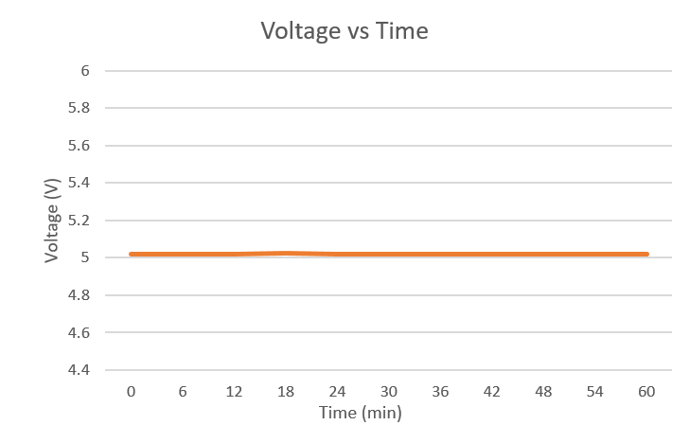
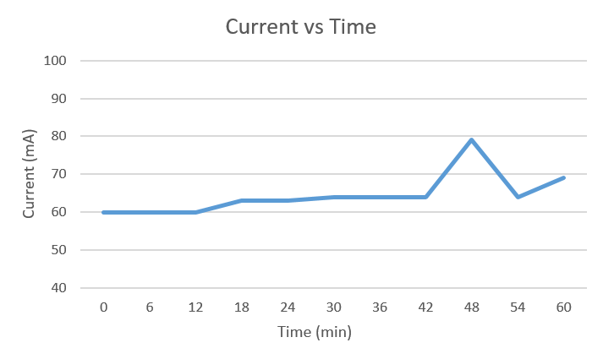
(a) Voltage over one hour
(b) Current over one hour

Slide 35
LED Protocol Testing

Slide 36
LED Type | Color | Protocol | Behavior | Satisfactory
Technical | Red | Low Battery | Blink twice every two seconds | N/A
Technical | Red | Full memory | Blink five times every two seconds | Yes
Technical | Red | Sensors inoperable | Blink slowly continuously | Yes
Operational | Green | Sensors recording | On continuously | Yes
Operational | Green | Sensors not recording | Off continuously | Yes
Operational | Green | Uploading data | Blink LED quickly | Yes
Operational | Green | USB connected | Blink LED slowly | Yes

Slide 37
User Interface

Slide 38
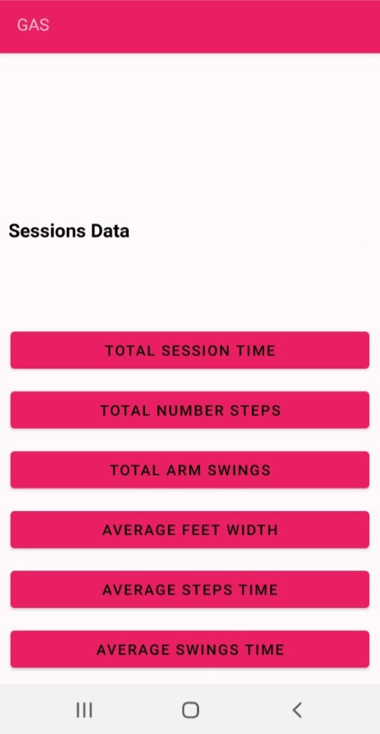
User Interface Design
The UI should transfer data successfully with the upload button.
The UI design should display data of the last uploaded session on charts.
The physical therapists need to identify the walking progress.

Slide 39
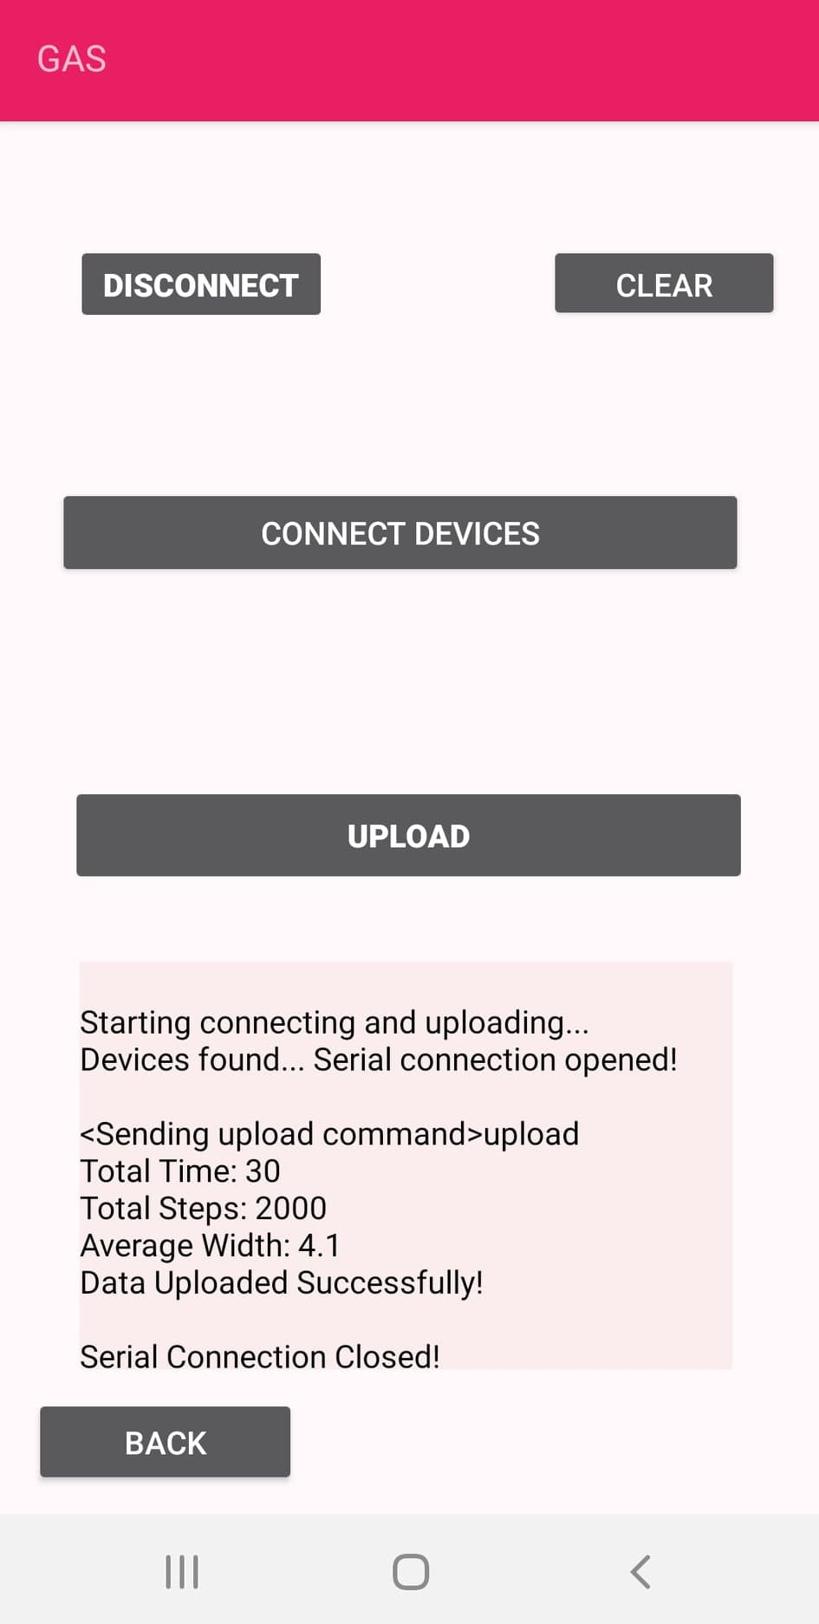
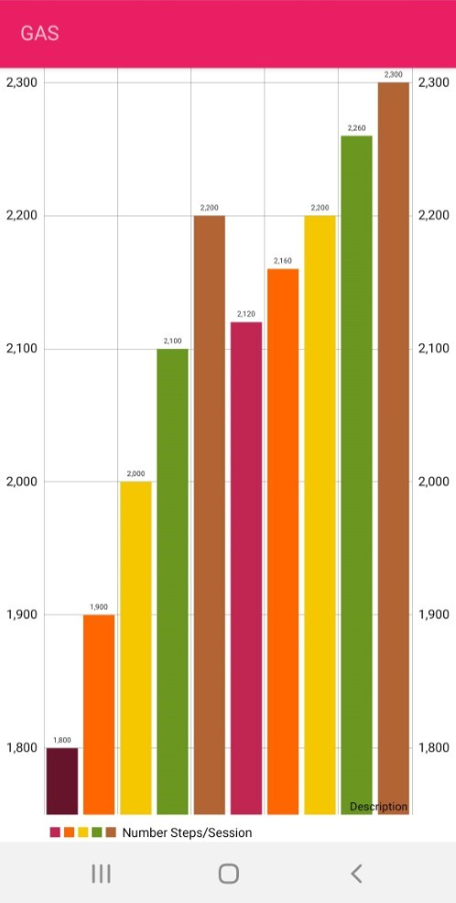
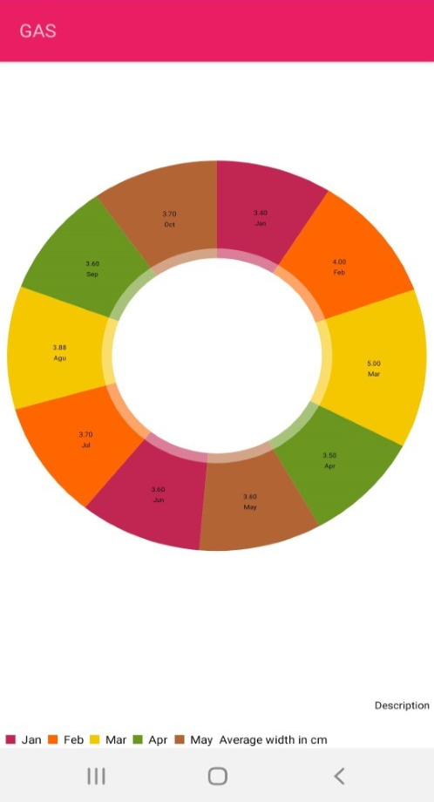
User Interface Testing

Slide 40

Plans and Conclusions

Slide 41
Future Plans
Implement fully-functional system
1
Refine device design
2
Potentially test in outpatient therapy
3

Slide 42
Conclusion
GAS provides a way to record gait-related data without a physical therapist
The device makes the jobs of physical therapists easier
Users' physical therapy experiences are more helpful and productive

Slide 43
References
[1] “MRI Non-Magnetic Transfer / Gait Belt.” [Online]. Available: https://www.ocelco.com/store/pc/MRI-Non-Magnetic-Transfer-Gait-Belt-p13096.htm [Accessed 30-Aug-2020].
[2] “Markers for gait analysis.” [Online]. Available: https://www.sciencephoto.com/media/1014006/view/markers-for-gait-analysis [Accessed 30-Aug-2020].
[3] "Woman is Walking." [Online]. Available: https://creazilla.com/nodes/22293-woman-is-walking-for-exercise-clipart [Accessed 30-Aug-2020].
[4] "Infrared Sensor Symbol." [Online]. Available: https://favpng.com/png_view/license-infrared-symbol-sensor-png/c6Bm1yxd [Accessed 30-Aug-2020].
[5] “FastStats - Body Measurements,” Centers for Disease Control and Prevention, 2020 [Online]. Available: https://www.cdc.gov/nchs/fastats/body-measurements.htm [Accessed 08-Sept-2020].
[6] “MIL-STD-1472D,” Abbott Aerospace Technical Library, 1989 [Online]. Available: https://www.abbottaerospace.com/wpdm-package/mil-std-1472d-human-engineering-design-criteria-for-military-systems-equipment-and-facilities/ [Accessed 07-Sept- 2020].
[7] Brach, J., Berlin, J., VanSwearingen, J., Newman, A. and Studenski, S., 2005. Too much or too little step width variability is associated with a fall history in older persons who walk at or near normal gait speed. Journal of NeuroEngineering and Rehabilitation, 2(1), p.21.
[8] “Universal Serial Bus Specification,” 2000 [Online]. Available: http://sdpha2.ucsd.edu/Lab_Equip_Manuals/usb_20.pdf [Accessed: 06-Sept-2020].
[9] "General Wellness: Policy for Low Risk Devices Guidance for Industry and Food and Drug Administration Staff, " U.S. Food and Drug Administration, 2016 [Online]. Available: https://www.fda.gov/media/90652/download [Accessed: 07-Nov-2020].
[10] "Your Health Information, Your Rights," The Office of the National Coordinator for Health Information Technology, 2017 [Online]. Available: https://www.healthit.gov/sites/default/files/YourHealthInformationYourRights_Infographic-Web.pdf [Accessed 07-Nov-2020].
[11] "Computer with Positive Graph Clipart." Available: https://www.pinclipart.com/pindetail/ihboJxb_computer-with-positive-graph-clipart/ [Accessed 08/30/2020].

Slide 44


Appendix A: Target Audience
Outpatient therapy, home health, and inpatient rehabilitation
Sensors measure average step time, average step width, average arm swing time, and relative position of arms and legs
Useful for determining if patient is a fall risk
Presents averages in a graph as they change over time
Other information reported in tables
[11]

Slide 45
Appendix B: LED Protocol
Since there are only two LEDs, state control is shared. A priority is set for each LED type if multiple states are active.
Protocol | LED Type | Priority
Low battery | Technical | 1
Full memory | Technical | 2
Sensors inoperable | Technical | 3
Uploading data | Operational | 1
USB connected | Operational | 2
Sensors not recording | Operational | 3
Sensors recording | Operational | 4

